Slide 1

Data Structures Topic: Insertion in Linked List

Slide 2
Outlines
Insertion Algorithm
Insertion at the beginning
Insertion after a given node
Insertion at the end
Insertion into a sorted list
Review Questions

Slide 3
Insertion into a Linked List
New node N (which is to be inserted) will come from AVAIL list.
First node in the AVAIL list will be used for the new node N.
Types of insertion:
Insertion at the beginning
Insertion between two nodes
Insertion at the end

Slide 4
Checking the Available List
AVAIL
ITEM
Ø
Free-Storage List
NEW

Slide 5
Insertion at the beginning of Linked List
START
Ø
ITEM

Slide 6
3.INSERTION IN LINKED LIST
Insertion into an unsorted linked list is generally performed either at the beginning or at the end of the list .In sorted linked list ,new data can be inserted in the middle but the order has to be maintained.
To insert a new node into a linked list , we need to first create space and then insert data in the INFO part.
The space for the new node is made available from the free storage list or AVAIL list.

Slide 7
If AVAIL=NULL(space is not available) no insertion could be done
If AVAIL !=NULL(Node available) then the first node from the free storage list is removed and pointer variable NEW is used to point to this new node.
On removing the first node from the free storage list,AVAIL pointer now points to next node in the free storage list.
Finally data is inserted into INFO(NEW)<-ITEM

Slide 8
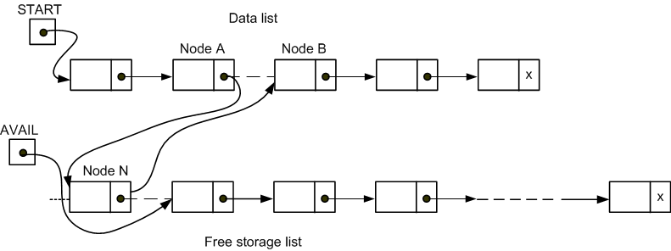

Slide 9
3.1INSERTION AT THE BEIGNNING OF LIST
INSTBEG(HEAD,ITEM,AVAIL)-Given LIST first node address is stored in HEAD. This algorithm inserts ITEM as the first node in the linked list. Here we use a local variable NEW that points to new node and AVAIL pointer pointing to the first node of free storage list

Slide 10
1.If AVAIL=NULL then [Overflow ,Avail list empty]
Write “OVERFLOW”
return
[end of IF structure]
2.NEW←AVAIL
3.AVAIL←LINK(AVAIL) [Update AVAIL]
4.INFO(NEW)←ITEM [copy ITEM into INFO part of new node]
5.[make the new node’s link part points to first node of the list]
LINK(NEW)←HEAD //as head contain address of first node,now new contain address of first node.
6.[Update HEAD pointer so that it points to new node]
HEAD←NEW
7.Return

Slide 11
3.2INSERTING NODE AFTER A GIVEN NODE
We first create a new node from the free storage list.
We check the value of LOC,if LOC=NULL then new node is inserted as the first node of list.
If LOC !=NULL,we point the new node N to the successor node X.The address of new node’s successor can be found from node X’s link part.
After this we set the link part of node X to now point to the new node N..

Slide 12
INSTLOC(HEAD,ITEM,AVAIL,LOC)-Given LIST first node address is stored in HEAD.This algorithm inserts ITEM either after the node whose location is LOC or inserts ITEM at the front if LOC=NULL.Here we use a local pointer variable NEW that points to a new node.

Slide 13
1.If AVAIL=NULL then [Overflow ,Avail list empty]
Write “OVERFLOW”
return
[end of IF structure]
2.NEW←AVAIL
3.AVAIL←LINK(AVAIL) [Update AVAIL]
4.INFO(NEW)←ITEM [copy ITEM into INFO part of new node]
5.If LOC =NULL then [Insert new node at the beginning]
LINK(NEW)←HEAD
HEAD←NEW
Else [Inserts after node X having location LOC]
LINK(NEW)←LINK(LOC) [Update link part of new node]
LINK(LOC)←NEW [Update link part of node X to point to new node]
[End of If Structure]
6.Return

Slide 14
3.3 INSERTING A NODE AT THE END OF LIST
Create new node from the free storage list and store ITEM into INFO part of this node.
LINK part must be set to NULL.
We use a pointer variable PTR which is first intialized to HEAD and then we navigate through the nodes in the list till you get a node whose link part is NULL.

Slide 15
INSTEND(HEAD,ITEM,AVAIL)-Given LIST’s first node is stored in HEAD.This algorithm inserts ITEM at the end of the list.Here we use two local pointer variables NEW and PTR.The NEW points to the new node.The PTR navigates the linked list so as to find the location of the last node after which new node is to be inserted.

Slide 16
1.If AVAIL=NULL then [Overflow ,Avail list empty]
Write “OVERFLOW”
return
[end of IF structure]
2.NEW←AVAIL
3.AVAIL←LINK(AVAIL) [Update AVAIL]
4.INFO(NEW)←ITEM [copy ITEM into INFO part of new node]
5.LINK(NEW)←NULL [Set link part of the new node to NULL]
6.[Searches for location of last node of linked list]
PTR←HEAD [Intialize PTR to HEAD]
7.Repeat while LINK(PTR) !=NULL
PTR←LINK(PTR)
[End of loop]
8.LINK(PTR)←NEW [Set link part of PTR to point to new node]
9.Return.

Slide 17
3.4INSERTION IN THE SORTED LIST

Slide 18
INSTSORT(HEAD,ITEM,AVAIL)-Given LIST’s first node address in contained in HEAD.This algorithm inserts ITEM into sorted linked list based on the value of ITEM.The local variable PTR points to the current node being processed and pointer variable PREVPTR points to its predecessor.The local variable NEW points to the new node and AVAIL pointer points to the first node in the free storage list.

Slide 19
1.If AVAIL=NULL then [Overflow ,Avail list empty]
Write “OVERFLOW”
return [end of IF structure]
2.NEW←AVAIL
3.AVAIL←LINK(AVAIL) [Update AVAIL]
4.INFO(NEW)←ITEM [copy ITEM into INFO part of new node]
5.LINK(NEW)←NULL [Set link part of the new node to NULL]
6.[Is the list empty?]
If HEAD=NULL then
HEAD←NEW [set NEW as HEAD of new list]
Return [end of if structure]
7.[Traverse the list if non-empty]
PTR←HEAD [set PTR to HEAD of the list]

Slide 20
8.PREVPTR←NULL [set PREVPTR to NULL]
9.Repeat while PTR!=NULL and ITEM>INFO(PTR)
[Update pointers]
a)PREVPTR←PTR
b)PTR←LINK(PTR)
[End of step 9 loop]
10.[Does new node precede all nodes in list?]
If PREVPTR =NULL then [Insert new node at the front]
a)LINK(NEW)←HEAD
b)HEAD←NEW
Else [Insert new node somewhere in the middle or at the end]
a)LINK(NEW)←PTR
b)LINK(PREVPTR)←NEW
[End of step 10]
11.Return.

Slide 21


Slide 22
Review Questions
What is the condition for the list being empty?
How will you insert a node in a linked list after a given node?
Which pointer fields are changed when:
a node is inserted after a given node
a node is inserted at the end of list
a node is inserted at the beginning of the list.

Slide 23
Review Questions
Correct the following algorithm such that ptr contains the address of the last node:
Set PTR = START
Repeat Steps 3 WHILE PTR != NULL
Set LINK[PTR] = PTR.
[End of the Loop]
4. Return PTR.

